Slide 1
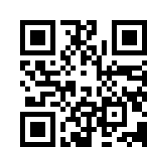
@UPennEEJust
Mission:
Serve the general academic, social and professional needs of the biomedical community, with an emphasis on the retention and professional development of Black and underrepresented minorities in BGS.
Notes:
Through academic social and career oriented events

Slide 2
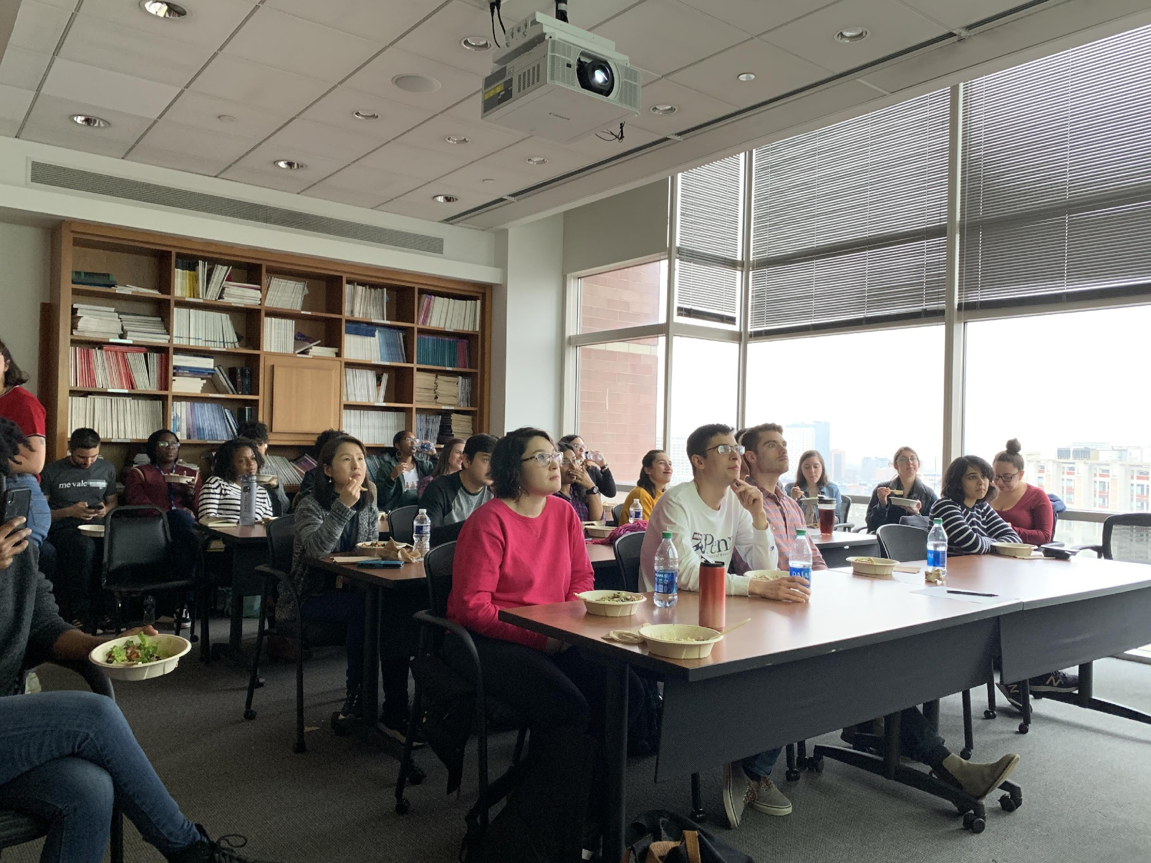
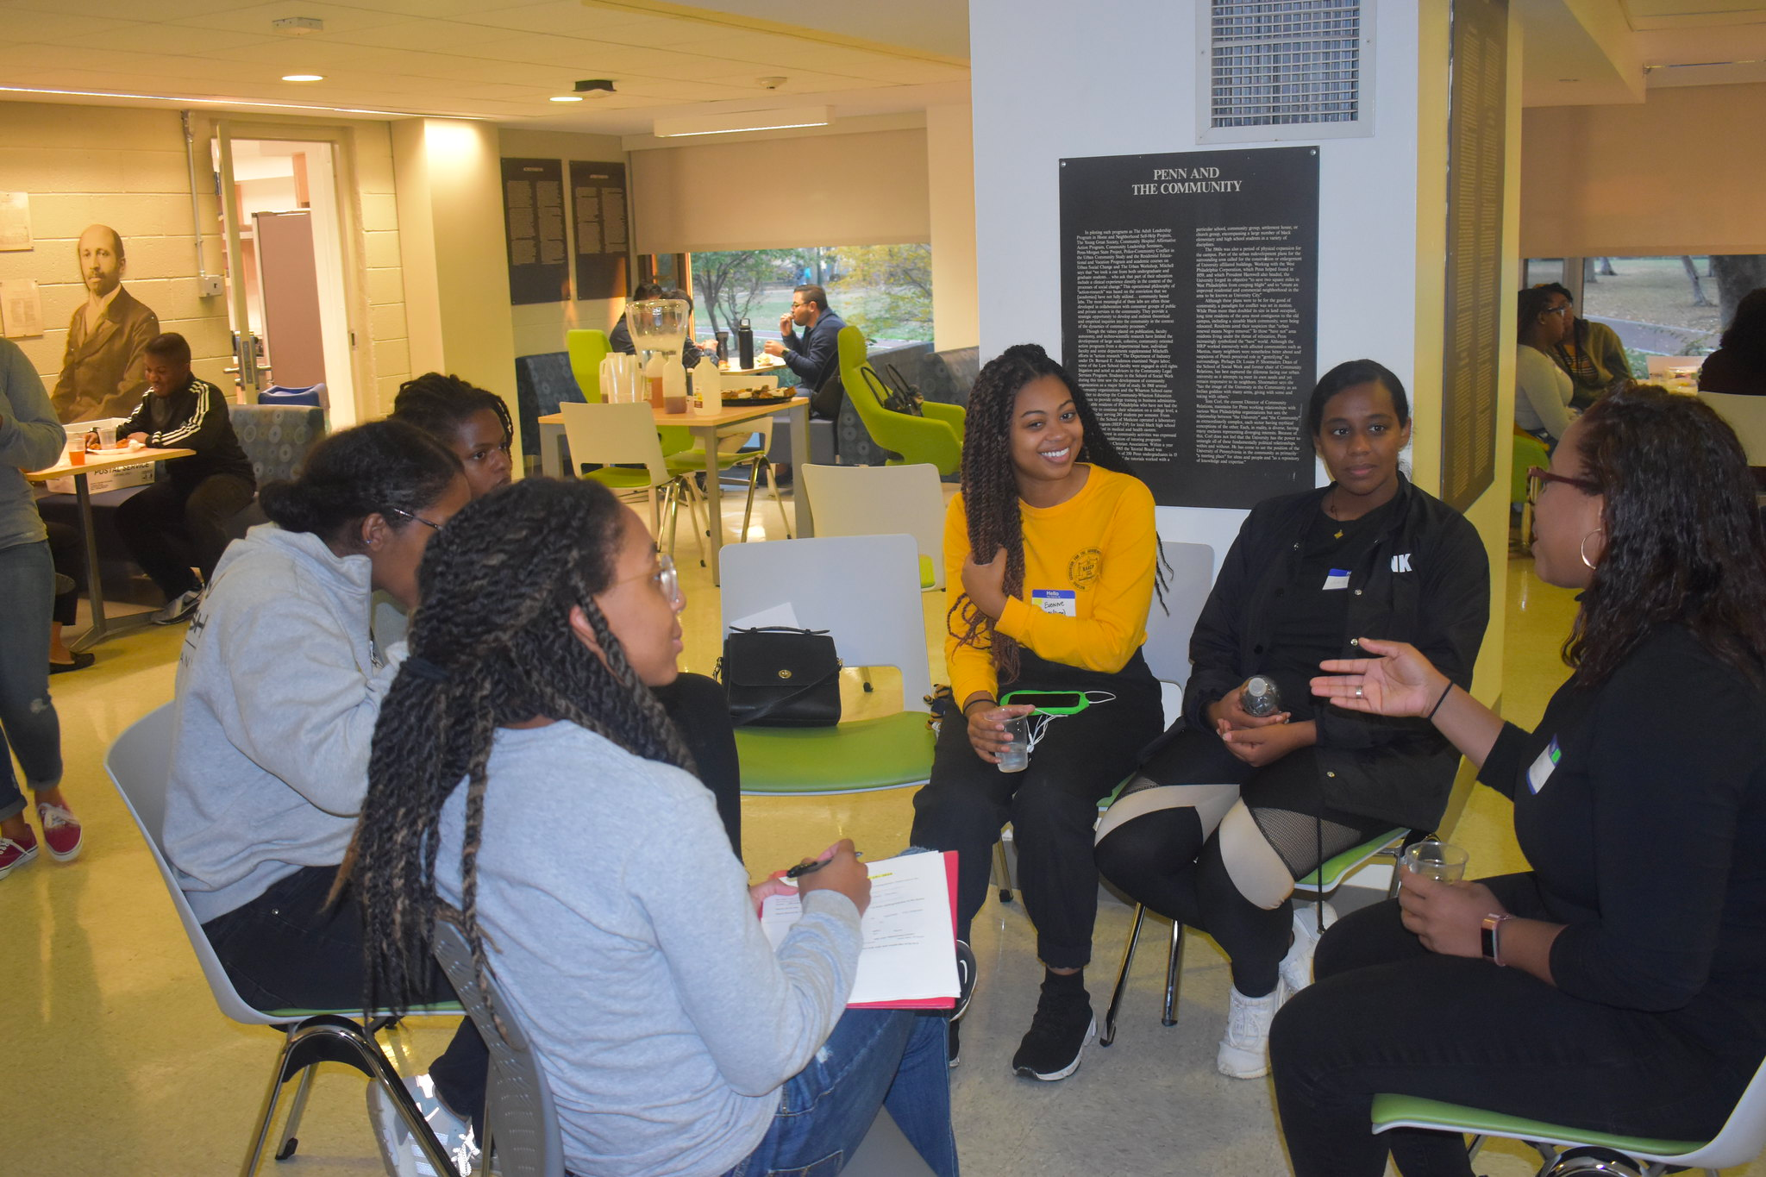
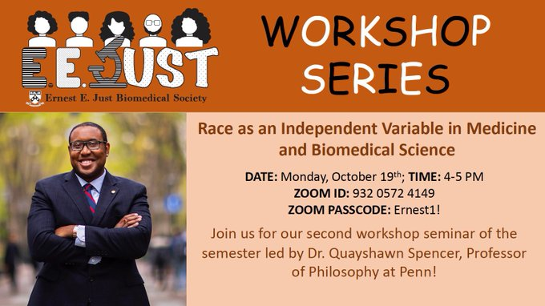
Academic and Professional Development
Reading Group and Workshop
Seminar Series
Notes:
Networking, mentoring circles, Prelim practice talks, career services, how to choose a lab/rotation tips
Facilitate professional growth to help us navigate grad school and make connections outside grad school

Slide 3
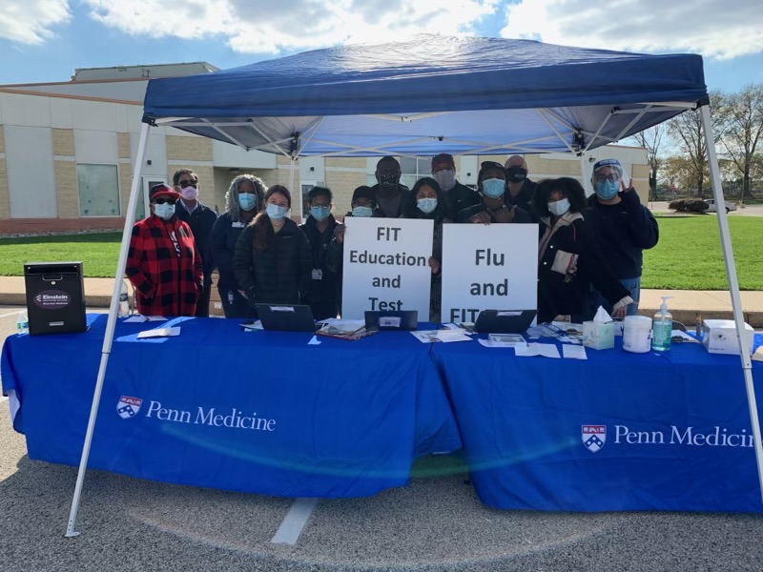
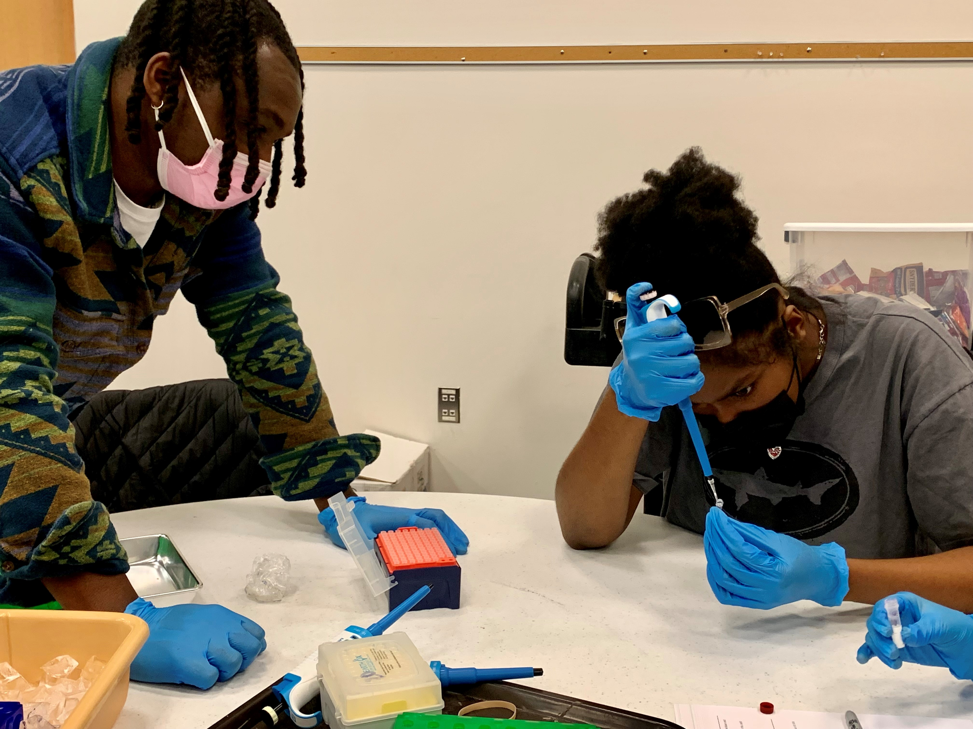
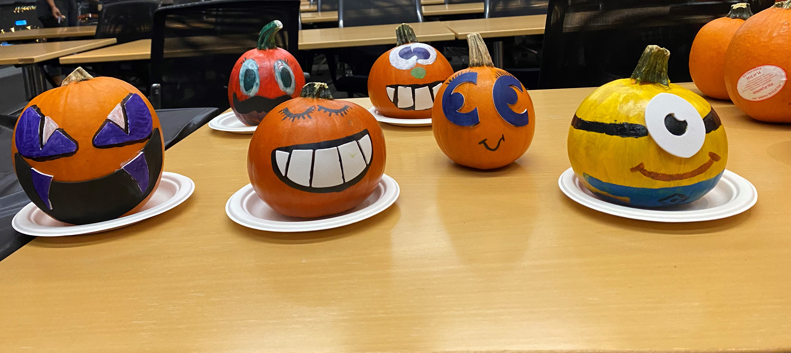
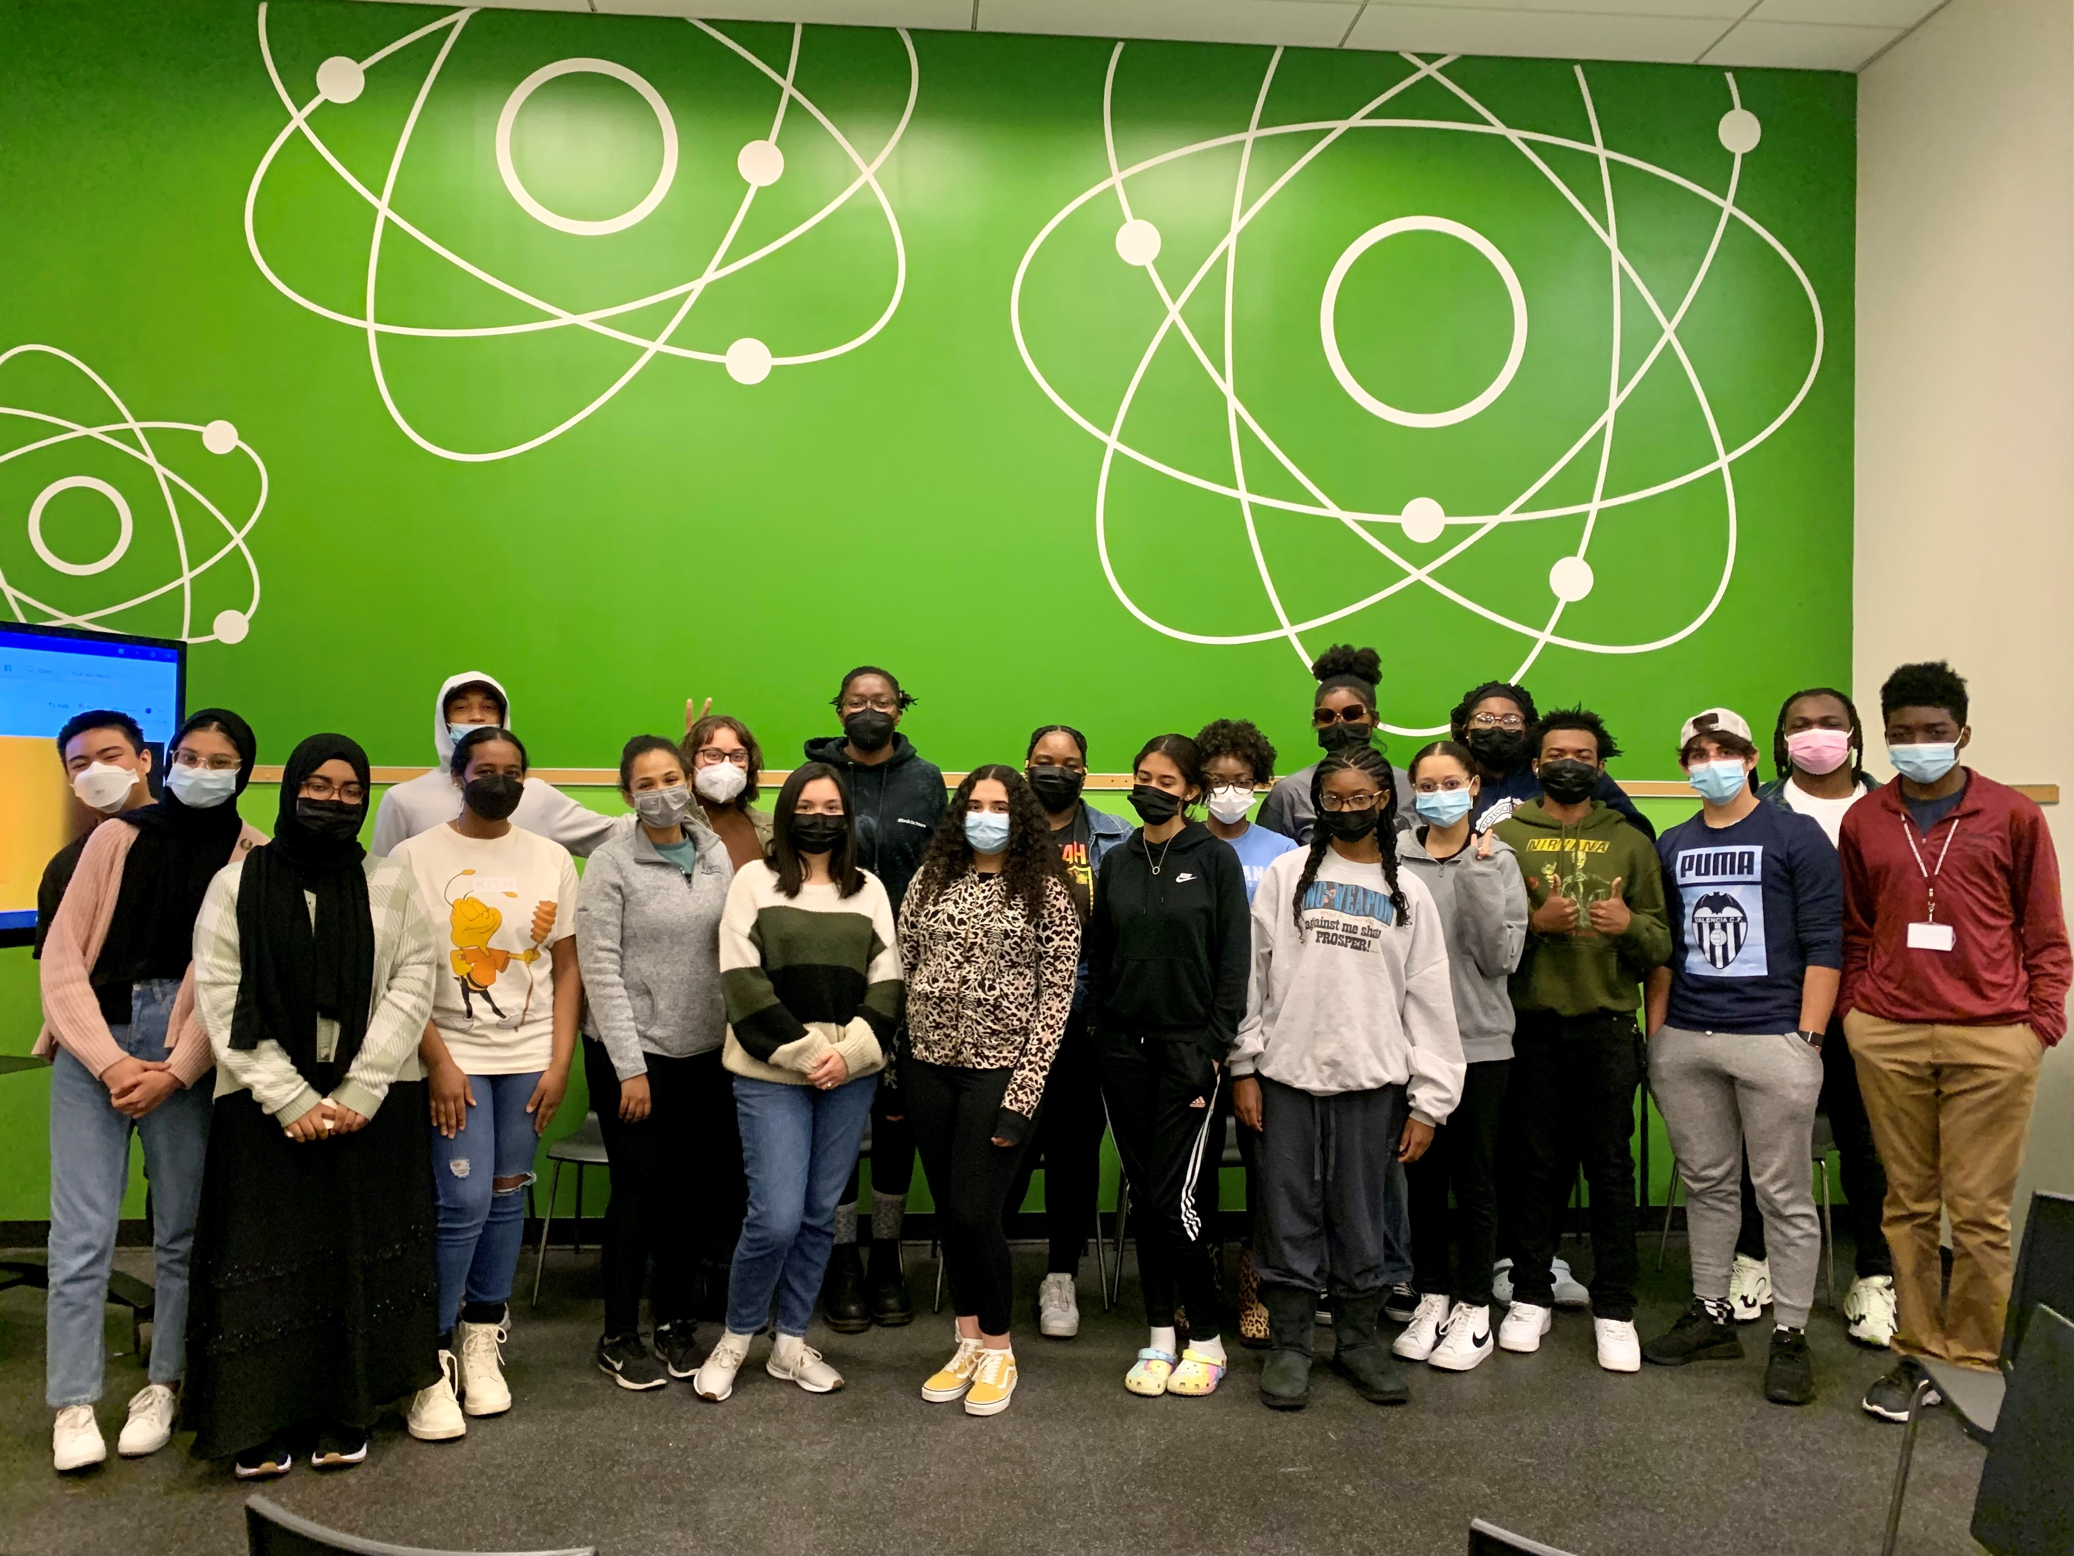
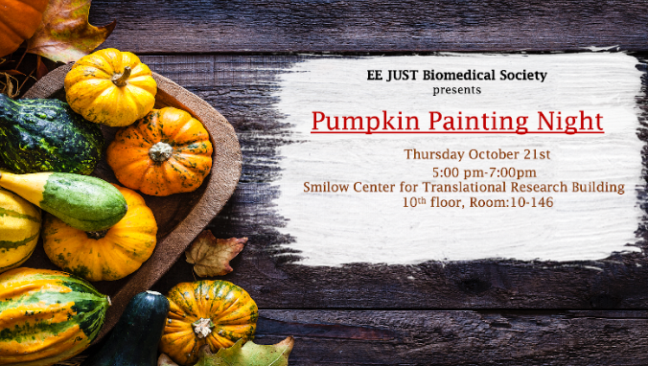
Social Events
Outreach
Notes:
BBQs, paintnight, happy hours,
We have some virtual social things now.

Slide 4
